Slide 1
Web-based Graph Drawing

Slide 2
Agenda
Introduction
Graph Drawing
My demo
Graphviz
TODO

Slide 3
My Purpose
Draw automata
When learning Dragon Book
No handy tools
Graphviz – dot language
I thought it would be easy
Use d3.js
Draw vertices
Draw edges
Done!

Slide 4
Really Easy?
Real Difficulty
Layout vertices, where?
Draw edges, how?
Graph Drawing
An area of mathematics and computer science

Slide 5
Graph Drawing
Quality measures - aesthetic criteria
Crossing edge number
Edge shape and length
Straight and short edge
Aspect ration
ΣS(BoundingBox)/S(DrawingArea)
Angular resolution
Determined by sharpest angle
Notes:
σ

Slide 6
Graph Drawing
Layout methods
Force-based
My demonstration
Layered
Graphviz - dot
Tree
Circular
http://circos.ca/
http://bl.ocks.org/mbostock/4062006
others
Notes:
σ

Slide 7
Graph Drawing
Layout methods
Force-based
My demonstration
Layered
Graphviz - dot
Tree
Circular
http://circos.ca/
http://bl.ocks.org/mbostock/4062006
others
Notes:
σ

Slide 8
My Demo
Draw Automata
Force-based layout
3rdParty Libraries
D3.js
Data-Driven Documents
Not a visualization library
Efficient manipulation of documents based on data
Springy
Provides layout algorithm
Notes:
σ

Slide 9
Spring Model
Physical simulations
Edge -> Spring
Hooke’s Law
Vertex -> Electric Charge
Coulomb’s Law
Advantages
Good, Interactive, Intuitive, Simple….
Disadvantages
Slow
Notes:
σ

Slide 10
Springy code
Graph
Layout
Renderer
Layout.ForceDirected.prototype.start()
Notes:
σ

Slide 11
D3.js
Based on SVG
Other libraries
Rapael
SVG for modern browsers
VML for IE6-8
Notes:
σ

Slide 12
My Demo code
Integration
Use springy.js to generate vertices positions
Use D3.js to draw SVG
Notes:
σ

Slide 13
Graphviz
Graph Visualization Software
Made by AT&T Bell Laboratories
Open source
GUI tools, CMD tools, Library
Support many layouts
Export formats
SVG
PDF
PNG
…
Notes:
σ

Slide 14
Supported Layouts of Graphviz
Dot
Layered
For directed graph
Twopi – radical layout
Circo – circular layout
Patchwork – tree layout
Neato, fdp, sfdp – spring model
Notes:
σ

Slide 15
Dot Language
Dot language
plain text graph description language
graph MyGraph {
a -- b -- c;
b -- d;
}
Notes:
σ

Slide 16
Algorithm of Dot Layout
Four Pass
Rank
Ordering
Position
Draw Edge
Notes:
σ

Slide 17
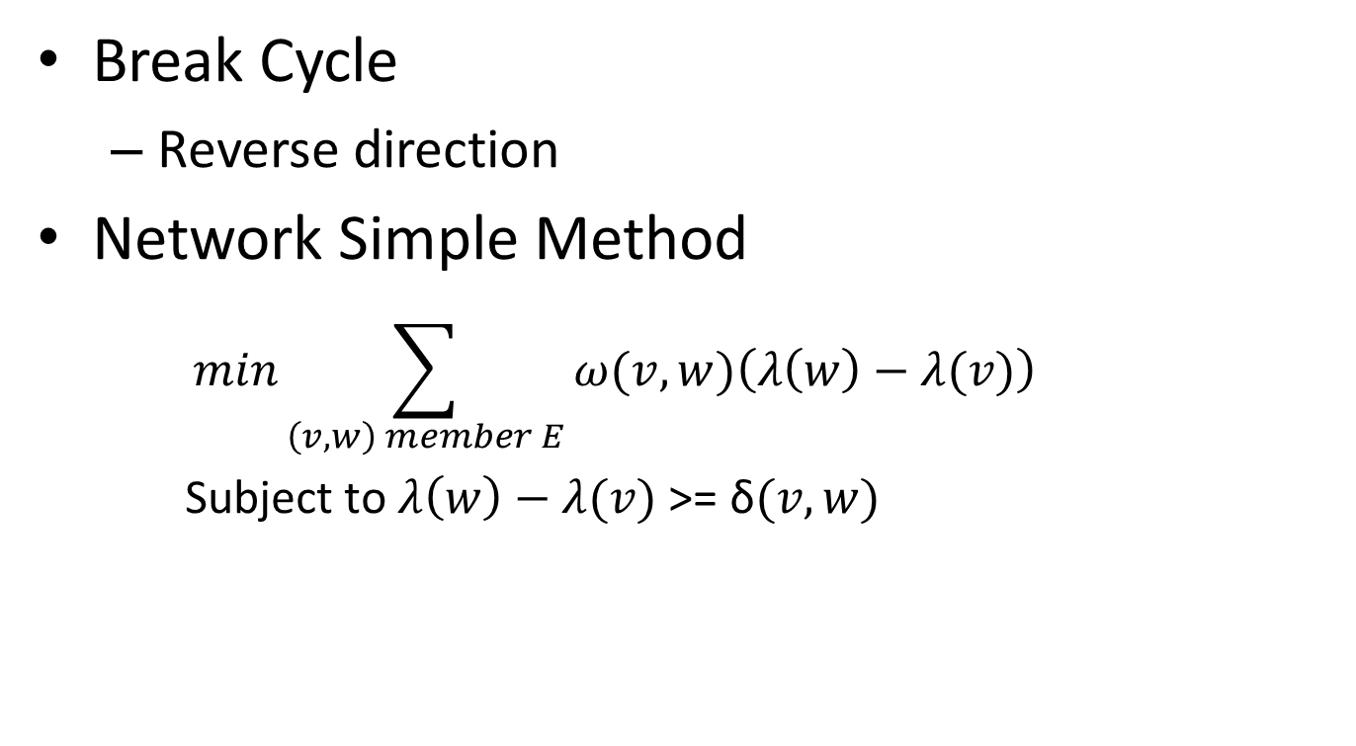
Rank
Break Cycle
Reverse direction
Network Simple Method
$$min\sum_{\left(v,w\right) member E}{ω(v, w)\left(λ\left(w\right)−λ(v)\right)}$$
Subject to $λ\left(w\right)−λ(v)$ >= δ$(v,w)$
Notes:
σ

Slide 18
Ordering
Break Cycle
Network Simplex Method
Imagine you are the company that produces the commodity
What price should you sell the commodity for at each node?
Notes:
σ

Slide 19
Order, Position And Draw Edge
Order
Init and optimization
Barycenter function
Median function
Position
Init, do optimiztion
Draw edge
Edge between ranks
Flag edge
Self edge
Edge label – virtual node
Heuristic Approach
Notes:
σ

